Slide 1
Lecture 2: Basic Demographic and Health Indicators in India HS142 Introduction to India’s Health system 4th August 2022

Slide 2
Review Questions
1) What are health indicators in India?
2) What are the data sources for health indicators?

Slide 3
Health Indicators
Quantifiable characteristics of health of the population.
Comparable Information-Countries, regions and social groups.
Track, monitor and understand the progress in health of population.
Helps in policy making

Slide 4
Different Indicators of Health
1. Mortality Indicators: Associated with number of deaths in a population
2. Morbidity Indicators: Condition of being diseased in a population
3. Nutritional Status Indicators: Anthropometric measurement, height and weight
4. Healthcare delivery indicators: Doctor-Population Ratio
5. Utilisation rates: Use of health services
6. Indicators of social and mental health: Suicide, acts of violence & crime in society
7. Socio-economic indicators: Rate of Population increase, Per capita Income
8.Health Policy Indicators: Proportion of Gross National Product on health

Slide 5
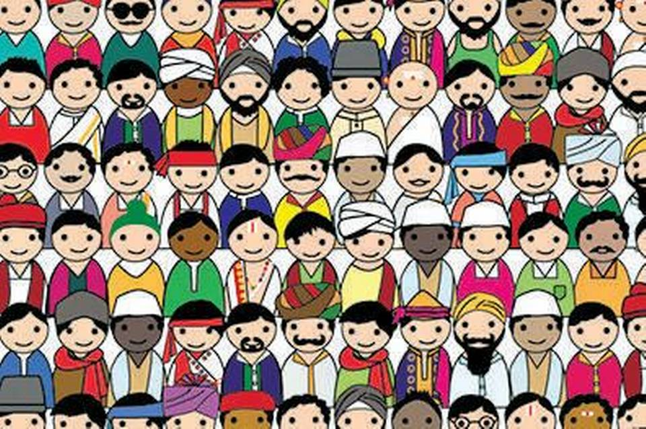
India’s Population
2011 Census:
Total Population: 1.21 billion; Males: 623.1 million; Females: 587.4 million
Rural Population 68.85% Urban: 31.15%

Slide 6
How does one understands that a population in a society or a country is healthy?

Slide 7
Life Expectancy at Birth
Average number of years that a newborn is expected to live if current mortality rates continue to apply.
Indicator of country’s level of development and overall health status
Disaggregated by sex, location (urban/rural, major regions/provinces).
India's Life Expectancy in 1951 for males- 32 years, females 31 years while in 2022-70 years: males 69 years and females 72 years (WHO 2022).
Low in comparison to developed and developing countries
In 2022, Japan 84 years while Nepal was 70 years and Bangladesh 74 years (WHO 2022)
Significant variation across different states in India-Kerala 74 years and Assam 63 years

Slide 8
Crude Birth Rate(CBR) and Crude Death Rate(CDR)
Crude Birth Rate:
Number of live births per year per 1000 of the population
CBR: Number of live births in the year*1000
Mid year population
India’s CBR in 2020 was 19 (SRS Bulletin, 2202) rural (21) urban (16)variation (SRS Bulletin, 2020)
Crude Death Rate:
Number of deaths per year per 1000 of the population
CDR: Number of deaths in the year*1000
Mid year population
India’s CDR in 2020 was 6, Rural 6.4 and 5.1 in urban areas(SRS Bulletin , 2020)

Slide 9
Source: Kulkarni 2014

Slide 10
Declining Birth and Death Rate in India
Source: SRS Bulletin 2020

Slide 11
Fertility Rate in India
Number of live births per 1000 women in the reproductive age group(15-49) in a given year
FR: Number of live births in an area during the year*1000
Mid year female population age 15-49 years in same year and same area
India's total fertility rate in 2019-21 was 2.0; urban areas: 1.6 and rural areas 2.1(NFHS 5, 2019-21)
Huge variation across different states, regions and social groups in India

Slide 12
Infant Mortality Rate
Number of deaths of infants under one year old in a given year per 1,000 live births in the same year.
IMR: Deaths of Infants under 1 year of age in a year*1000
Number of live births in a year
IMR of India in 2020 was 28/1000 live births; Urban areas 19 and Rural areas 31(SRS Bulletin 2020).
Significant differences between sex and states of India.
In 2020, IMR(India) 28/1000 live births, Males-28; females 28(SRS 2020).
IMR 2020 in Kerala was 6/1000 live births, Maharashtra 16; UP 38 and Assam 36(SRS 2020)

Slide 13
Declining IMR
Source: SRS Bulletin 2020

Slide 15
Neo-natal Mortality:
Early neonatal mortality refers to a death of a live-born baby within first seven days of life.
25/1000 live births as per the NFHS-5(2019-21). India report released in March 2022.
Late neonatal mortality covers the time after 7 days until before 28 days.
Child Mortality
Number of deaths at ages 1-5 years in a given year per 1000 children.
U5MR: Deaths of children < 5 years * 1000
Live births
In 2021, U5MR in India-42, Rural 46, Urban 32 (NFHS-5: 2019-21).

Slide 16
IMR, U5MR, NNMR and Life Expectancy, Selected Countries
Countries | Infant Mortality Rate |  | Under Five Mortality Rate |  | Neonatal Mortality | Life Expectancy (Years)
 | 1990 | 2019 | 1990 | 2019 | 1990 | 2020
Bangladesh | 100 | 26 | 144 | 31 | 19 | 73
India | 88 | 28 | 126 | 34 | 22 | 70
Nepal | 98 | 26 | 141 | 31 | 20 | 71
Pakistan | 106 | 56 | 139 | 67 | 41 | 67
Srilanka | 18 | 6 | 21 | 7 | 4 | 77
China | 42 | 7 | 54 | 8 | 4 | 77
Source: State of the Worlds Children 2020, UNICEF

Slide 17
Maternal Mortality Ratio
Refers to the death of a women while pregnant, during childbirth or within 42 days of delivery from postpartum infections.
MMR: Total number of female deaths due to complications of pregnancy, childbirth within 42 days in an area during a given year*100,000
Total Number of live births in the same area and year
In 2017-19, MMR: India 103/100000 live births compared in 2009: 212(SRS 2022).
Assam has the highest MMR at 205(SRS 2022)

Slide 18
MMR Contd

Slide 20
What are the Data Sources?

Slide 21
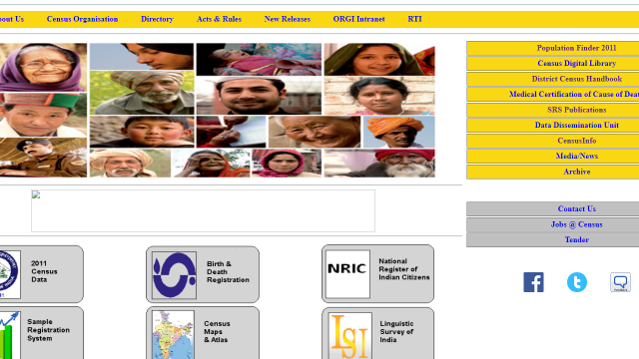
Census of India (http://censusindia.gov.in/)

Slide 22
Civil Registration System (CRS) India
Vital Statistics: Births, Deaths, Stillbirths
Process of continuous, permanent, compulsory and universal recording of vital events.
Registration of Births and Deaths Act, 1969
Births and Deaths to be registered within 21 days
Office of Registrar General, Ministry of Home Affairs, New Delhi
Number of registered live births; Number of registered deaths; Still births; Level of registration of births and deaths; Sex ratio based on registered births

Slide 23
Sample Registration System(SRS)
Objective: To generate reliable and continuous data on birth and death-important source for demographic data for socio-economic development and population control.
Started in 1964-65
Reliable : Dis-aggregations by age, gender and region
Ability to reliably calculate age specific mortality rates- like IMR, U-5 MR and Adult Mortality Rate
Office of Registrar General, Ministry of Home Affairs, New Delhi

Slide 24
District Level Household and Facility Survey (DLHS)

Slide 25
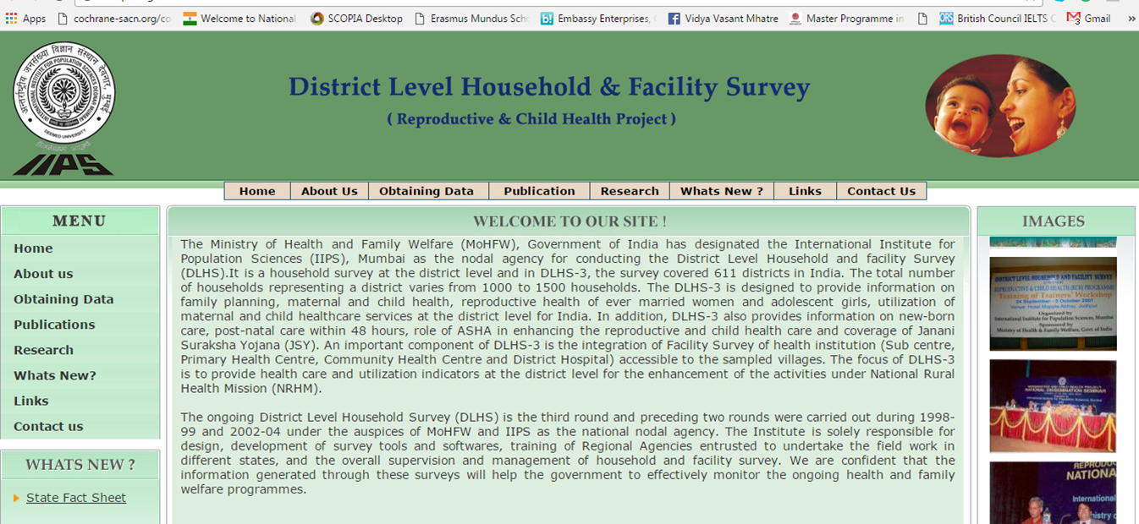
(http://rchiips.org/)

Slide 26
District Level Household and Facility Survey (DLHS)
Objective: Provide reproductive and child health related database at the district level.
Comes under umbrella of Ministry of Health and Family Welfare
Conducted by International Institute of population Sciences (IIPS), Mumbai
DLHS-1: 1998-99, DLHS-2: 2002-04, DLHS-3: 2007-08, DLHS-4: 2012-13
Helps in monitoring the progress in mother and child health after the launch of RCH programmes

Slide 27
District Level Household and Facility Survey (DLHS)-4
Maternal and child health
Immunization
Antenatal and delivery care
Awareness of RTI/STI
Birth registration
Anemia status/ blood pressure
Accessibility of health facility
Availability of health infrastructure and human resources

Slide 28
National Family Health Survey

Slide 29
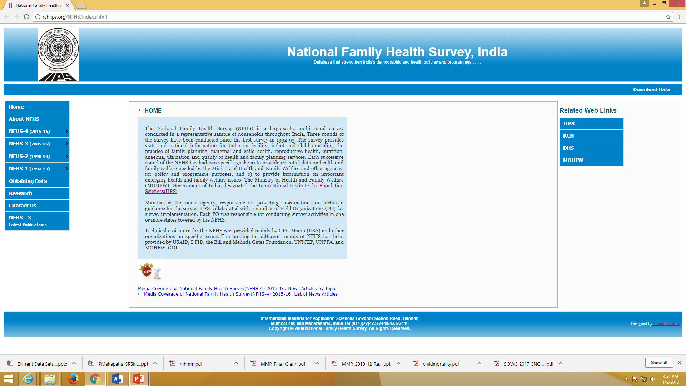
National Family Health Survey, India (http://rchiips.org/nfhs/index.shtml)

Slide 30
NFHS Contd
Large-scale, multi-round survey conducted in a representative sample of households throughout India
Launched by Ministry of Health and Family Welfare, 1992-93
Covers all States and Union Territories of India
Conducted by IIPS, Mumbai.
Objective: Provide essential data on health and family welfare and emerging issues in this area.
5 rounds of NFHS has been completed
1st 1992-93
2nd 1998-99
3rd 2005-06
4th 2015-16
5th 2019-21

Slide 31
NFHS Contd
Fertility rate/ infant mortality rate/ Under 5 mortality rate
Maternal and child health
Current need of family planning
Out of pocket expenditure
Institutional births and child feeding practices
Knowledge of HIV/ AIDS among adults
Treatment of childhood diseases

Slide 32
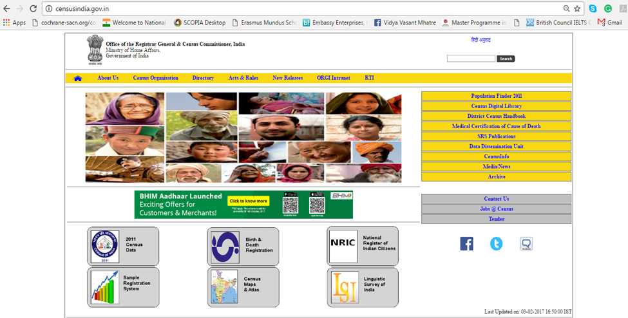
Annual Health Survey (ahs) (http://censusindia.gov.in/)

Slide 33
AHS
AHS is a panel survey. First Survey in 2010-11
Objective: provide benchmark for health and vital indicators at district level in 9 states ( high mortality and fertility rates): Bihar, Jharkhand, Odisha, Rajasthan, Madhya Pradesh, Chhattisgarh, Uttar- Pradesh, Uttarakhand and Assam.
Data collection: 4.28 million households spread in 284 districts.

Slide 34
Annual Health Survey
Crude birth rate
Natural growth rate
Infant mortality rate
Neo-natal mortality rate
Under five mortality rate
Sex ratio at birth
Maternal mortality ratio

Slide 35
References
1)Government of India(2017) ‘National Health Profile of India’ Central Bureau of Health Intelligence, DGHS, New Delhi.
2) Sample Registration System(2017) ‘SRS-Bulletin’ Volume 51 No.1September.
3) Park, K (2009) Textbook of Preventive and Social Medicine, Bhanot Publishers, New Delhi.
4) NFHS-4(2016) ‘India-Factsheet’, IIPS, Mumbai.

Slide 36
Thank you

